Slide 1


Configure your Azure VMs using DSC and OMS Automation DSC
Ben Gelens

Slide 2

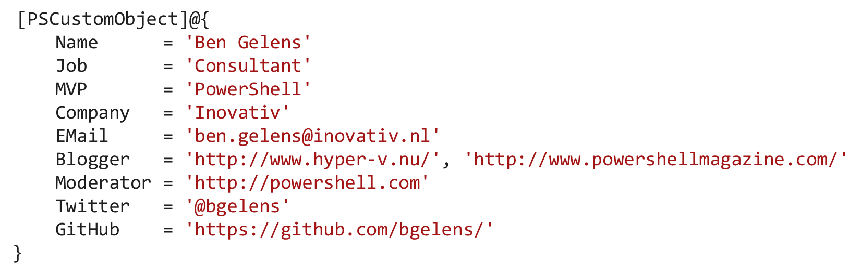
Ben Gelens

Slide 3
Agenda
Recap: What is DSC again?
VM DSC Extension
OMS Automation DSC

Slide 4
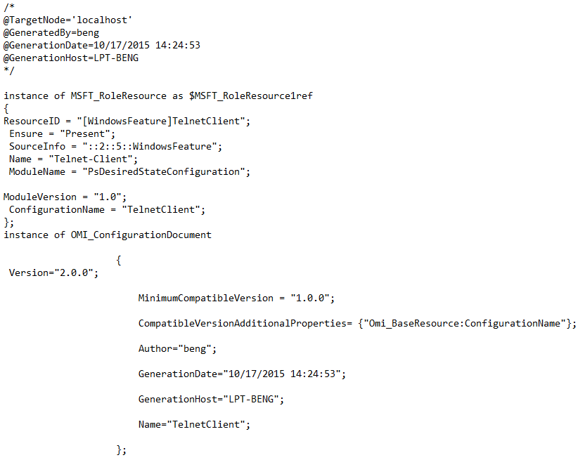
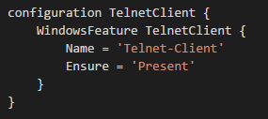
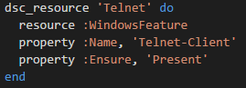
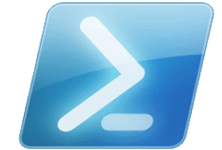


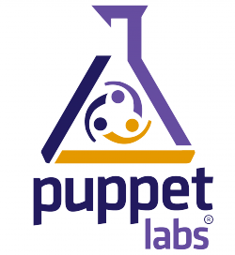

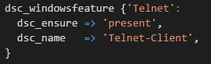
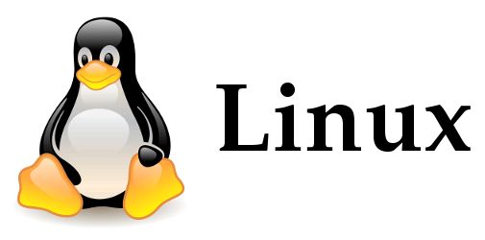

Recap: What is DSC again? Heterogeneous Configuration Management Platform
LCM
3rd Party Adapters
Resources

Slide 5

Recap: What is DSC again? MOF Push and Pull
Pull Server
Resources
CIM Session
Http(s) / SMB
Pre-staged resources
Push
Pull

Slide 6
VM DSC Extension Demo

Slide 7

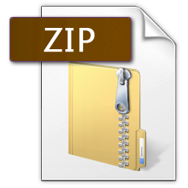
VM DSC Extension - Windows
Extension to the VM Agent
Utilizes DSC Push Mode
Rapidly updated / Improved: http://blogs.msdn.com/b/powershell/archive/2014/11/20/release-history-for-the-azure-dsc-extension.aspx
Config Data
Data payload
Configuration
Data payload
Config Data
Resources

Slide 8

VM DSC Extension - Linux
Installs OMI and DSC packages
Configures LCM for Push or PULL mode
Works with MOF and / or meta.mof (no configuration script)
Able to install / remove DSC resources
MOF
Meta.mof
Resource
Notes:
Announced: 26-10-2015
Ubuntu 12.04 LTS, 14.04 LTS
CentOS 6.5 and higher
Oracle Linux 6.4 and higher
openSUSE 13.1 and higher
SUSE Linux Enterprise Server 11 SP3 and higher

Slide 9
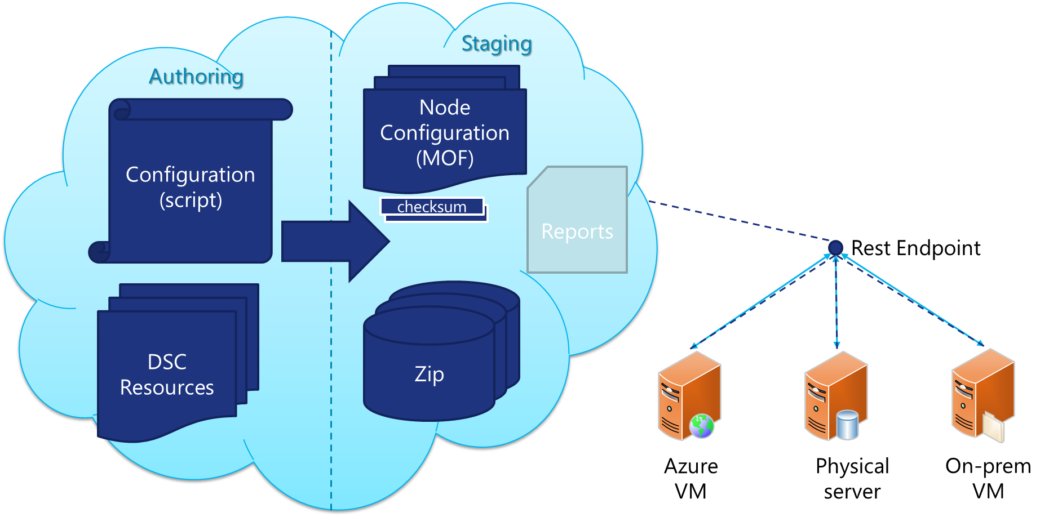
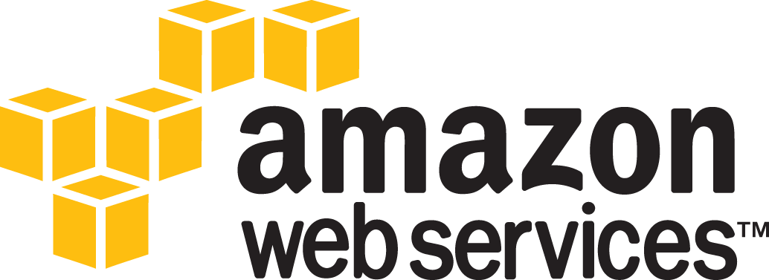
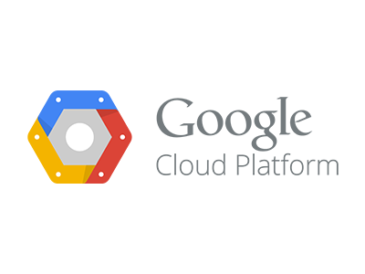

What is OMS Automation DSC?

Slide 10
OMS Automation DSC Demo

Slide 11
Experts Live 2015 wordt mede mogelijk gemaakt door:

Slide 12
Volgende sessie 17:00 – 18:00 uur
Closing Note

